Slide 1
TLS HANDSHAKE
Uche Akuma, Andrew Lappalainen
April 5, 2019

Slide 2
TABLE OF CONTENTS
OBJECTIVE
INTRODUCTION
TLS HANDSHAKE
UML
IMPLEMENTATION IN PYTHON
WIRESHARK CAPTURE
POPULAR ATTACKS ON TLS
RECOMMENDATION

Slide 3
OBJECTIVE OF THIS PROJECT
Simulate TLS handshake and conduct analysis into the security of the application data

Slide 4
INTRODUCTION
What is TLS/SSL?
Cryptographic protocols designed to provide communications security over a computer network

Slide 5
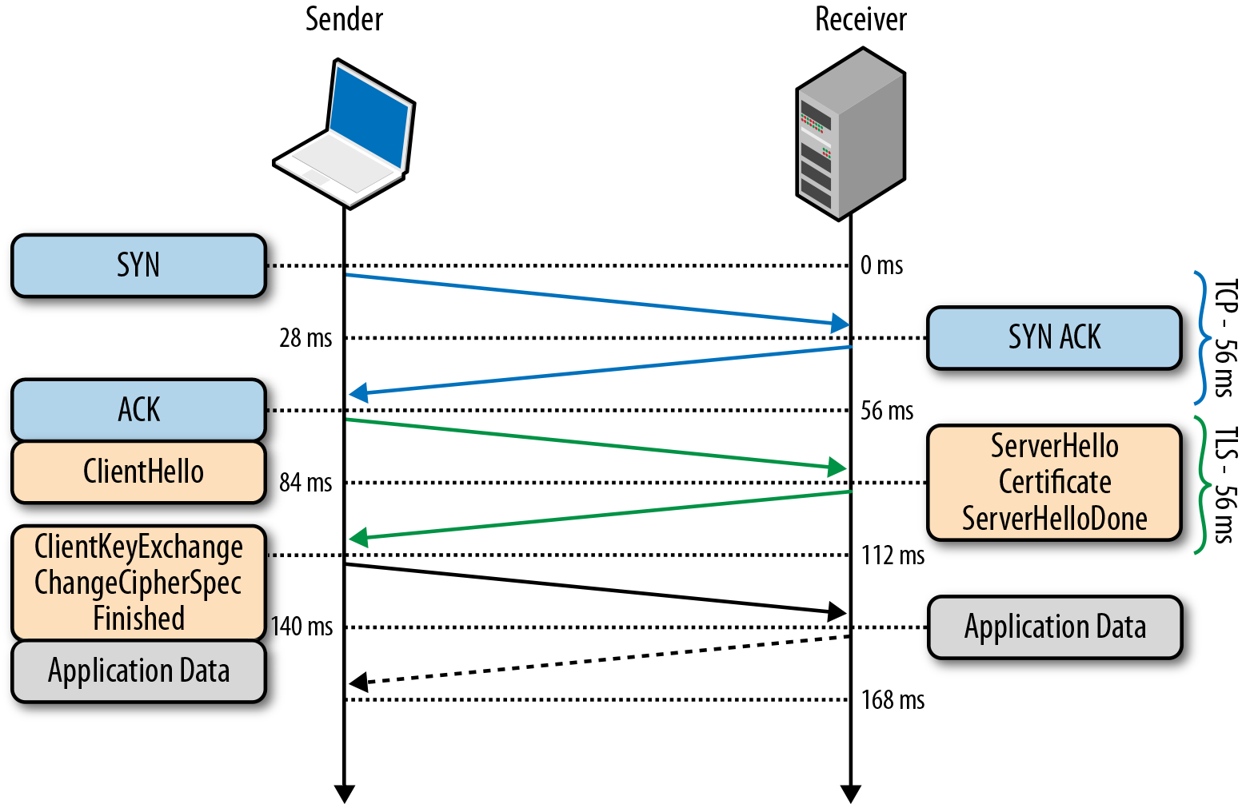
TLS HANDSHAKE

Slide 6
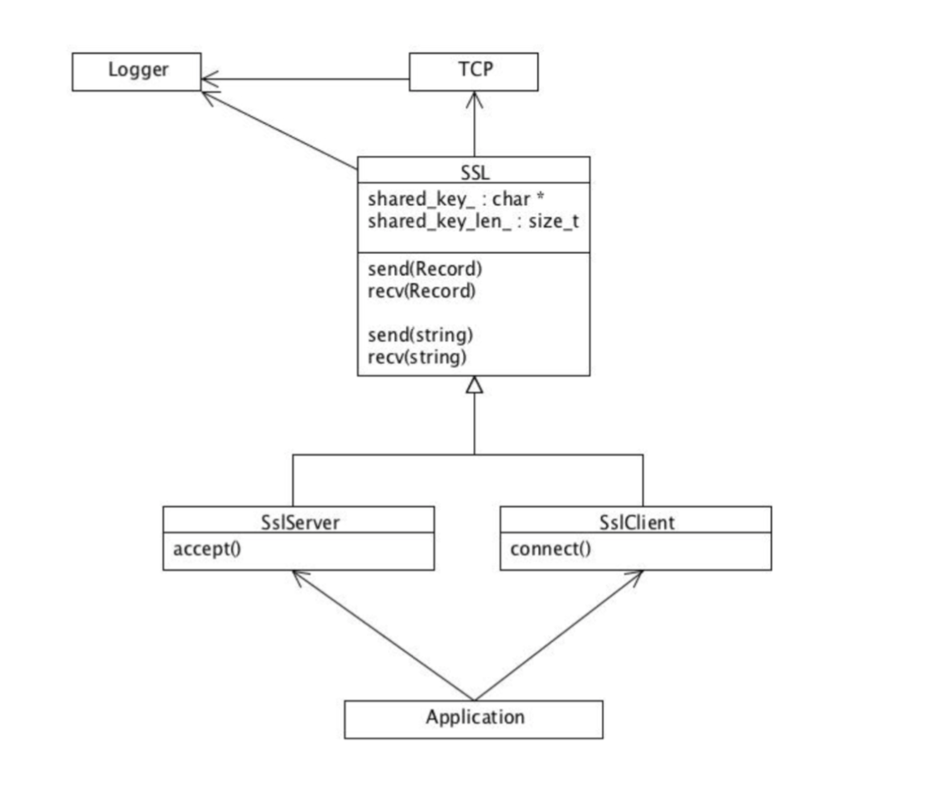
UML

Slide 7
IMPLEMENTATION IN PYTHON
Python socket and ssl modules
Establish secured connections
OpenSSL library
Open source toolkit supporting TLS/SSL
Issue certificates and keys
Support underlying cipher suites
Notes:
Socket module sets up connections between nodes
SSL module supports SSL and TLS, invoking underlying OpenSSL library
Simulates CA functionality: self-issue certificates and keys for client and server
Support underlying cipher suites required for key exchange, message authentication, encryption/decryption

Slide 8
WIRESHARK CAPTURE
Insecure connection vs TLS secured connection
DHE vs RSA key establishment
Client-server model
Server at port 50001
Client sends “test_message”

Slide 9
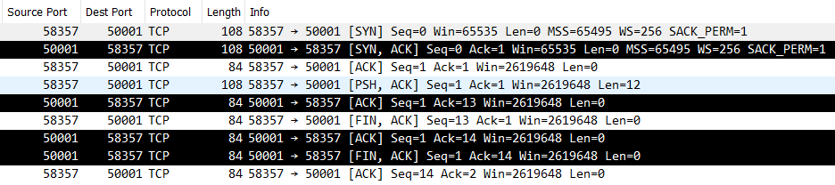
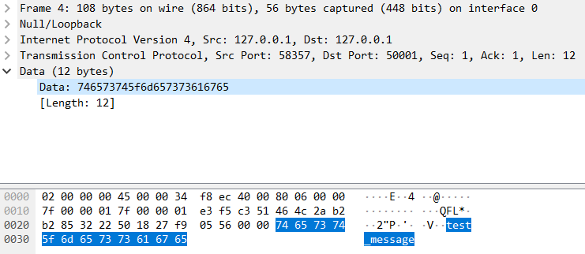
INSECURE CONNECTION

Slide 10
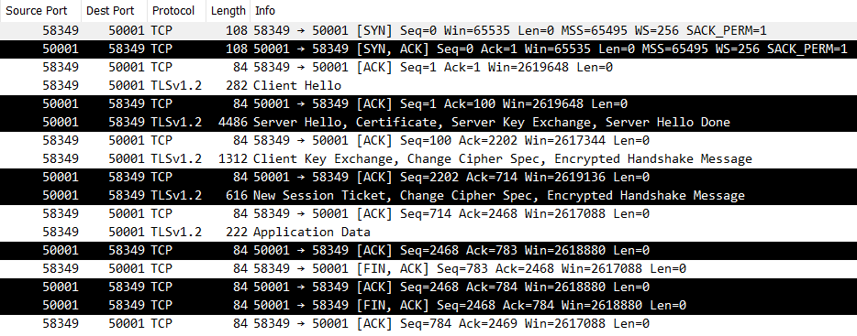
SECURE CONNECTION – DHE KEY ESTABLISHMENT

Slide 11
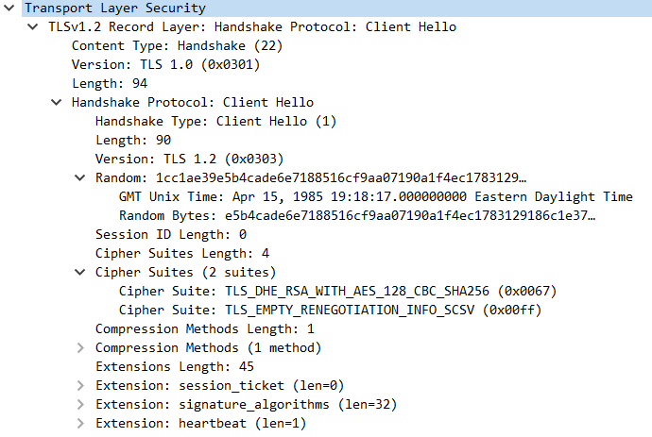
TLS DHE – CLIENT HELLO
Notes:
Client specifies it’s available cipher suites (forced to DHE in this case)
Client supplies a random number which is used for key derivation, but also secures against replay attacks

Slide 12
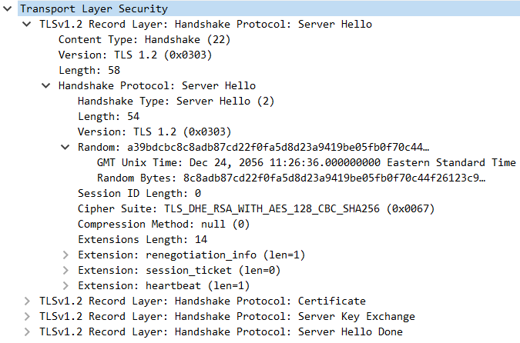
TLS DHE – SERVER HELLO
Notes:
Server replies back with the selected cipher suite and random number

Slide 13
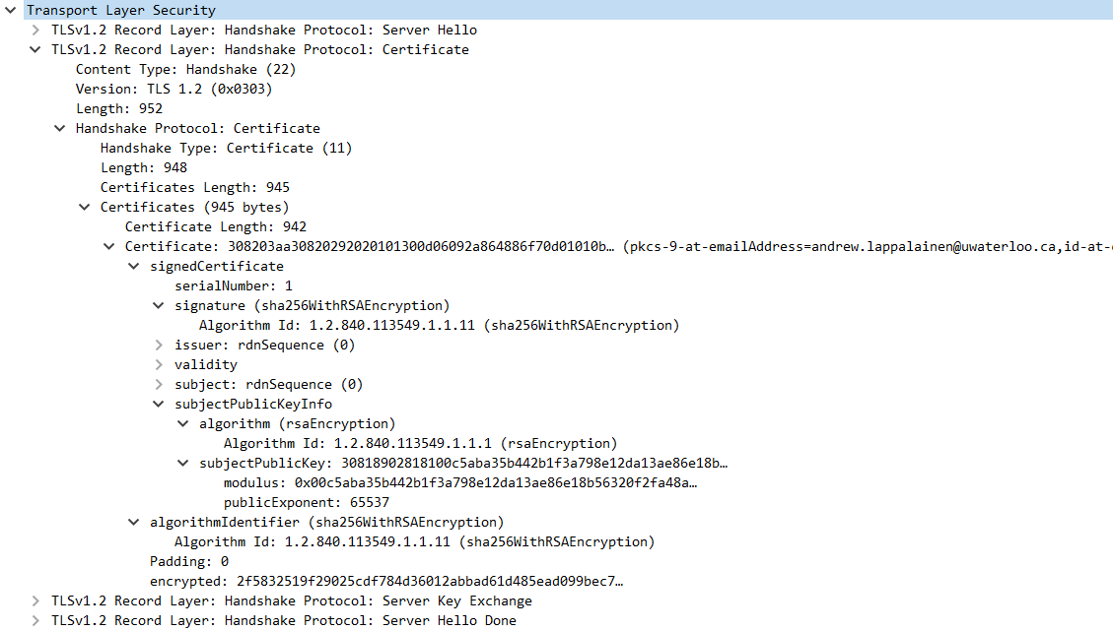
TLS DHE – SERVER CERTIFICATE
Notes:
Server replies back with the selected cipher suite and random number

Slide 14
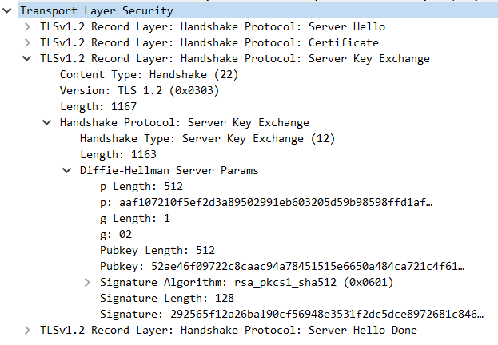
TLS DHE – SERVER KEY EXCHANGE
Notes:
Server replies back with the selected cipher suite and random number

Slide 15
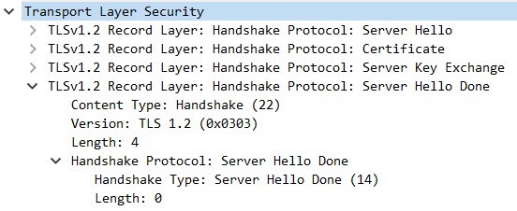
TLS DHE – SERVER HELLO DONE
Notes:
Server replies back with the selected cipher suite and random number

Slide 16
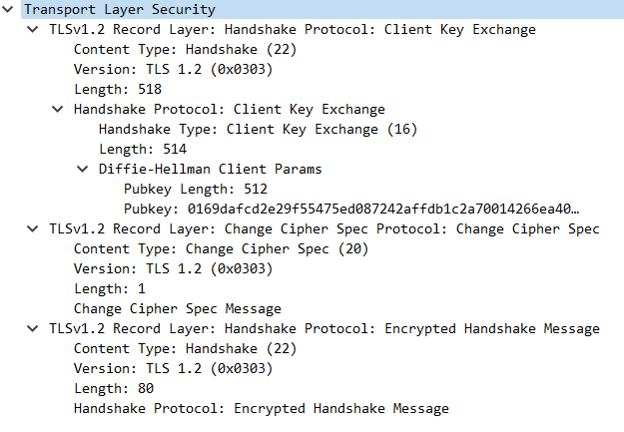
TLS DHE – CLIENT KEY EXCHANGE
Notes:
Server replies back with the selected cipher suite and random number

Slide 17
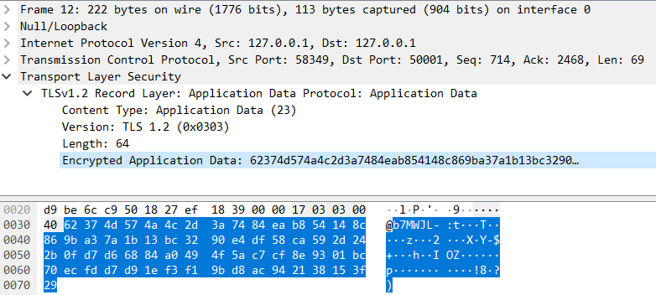
TLS DHE – CLIENT APPLICATION DATA
Notes:
Server replies back with the selected cipher suite and random number

Slide 18
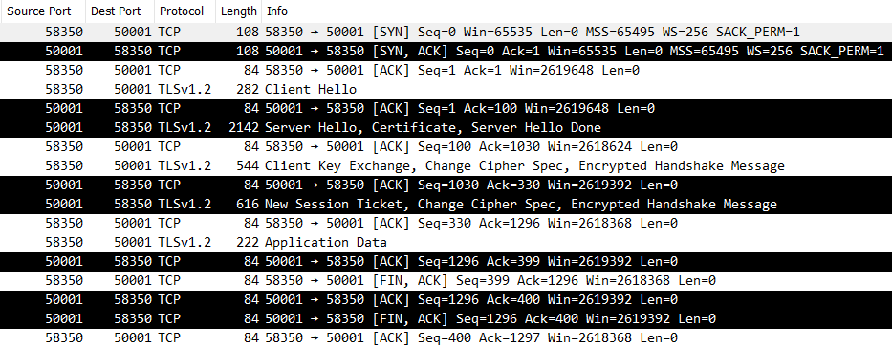
SECURE CONNECTION – RSA KEY ESTABLISHMENT

Slide 19
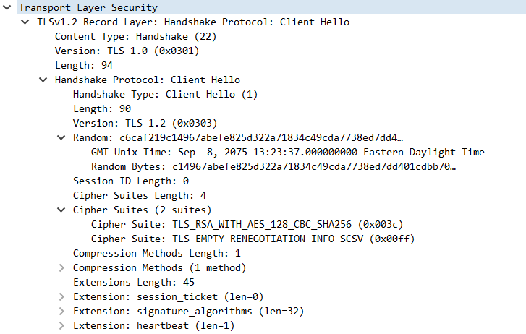
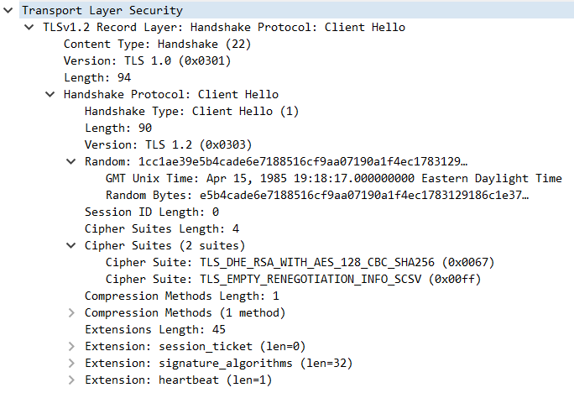
TLS RSA – CLIENT HELLO
Notes:
Client specifies it’s available cipher suites (forced to RSA in this case)
Client supplies a random number which is used for key derivation, but also secures against replay attacks

Slide 20
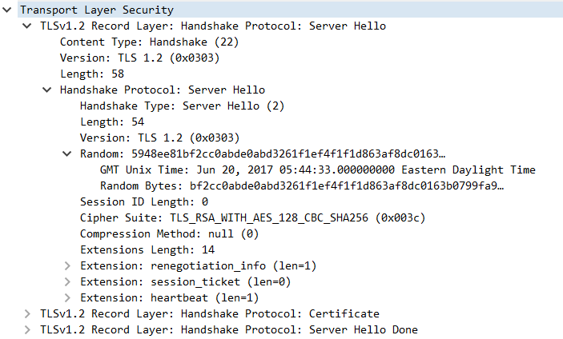
TLS RSA – SERVER HELLO
Notes:
Server replies back with the selected cipher suite and random number

Slide 21
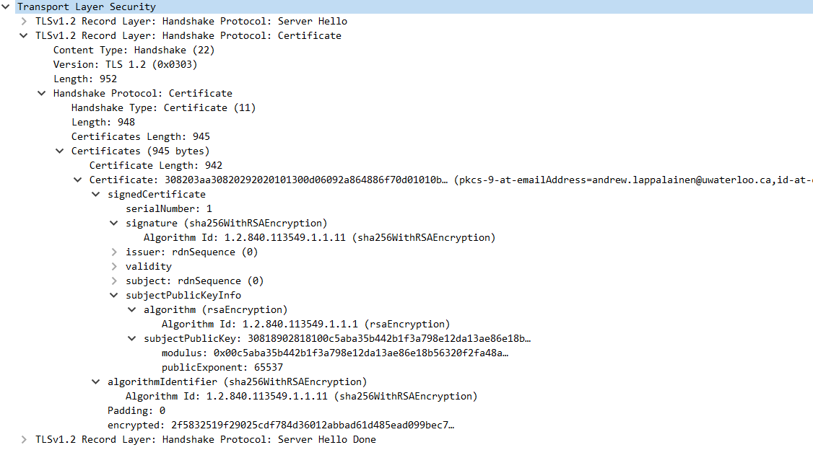
TLS RSA – SERVER CERTIFICATE
Notes:
Server replies back with the selected cipher suite and random number

Slide 22
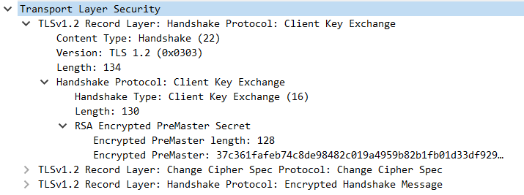
TLS RSA – CLIENT KEY EXCHANGE
Notes:
Server replies back with the selected cipher suite and random number

Slide 23
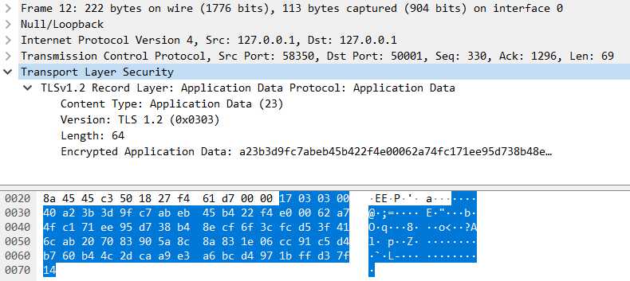
TLS RSA – CLIENT APPLICATION DATA
Notes:
Server replies back with the selected cipher suite and random number

Slide 24
POPULAR ATTACKS ON TLS
Compression attack
CRIME, TIME, and BREACH
Downgrade attack
POODLE
Cajole to run SSL instead of TLS.
TLS/SSL stripping
modifying unencrypted protocols that request the use of TLS

Slide 25
RECOMMENDATION
ECC over RSA for SSL/TLS certificates
ECC keys are smaller, meaning better performance with less overhead
ECC scales better, RSA gets cumbersome as keys grow bigger
ECC is less vulnerable to Quantum Computing

